Slide 1
PN Sequence Generator
By,
Prathamesh Khandekar
Anurag Malwee
Pronoy Mandal
(GROUP No.15)

Slide 2
Points to be discussed….
Concept behind the PN Sequence
General Block Diagram
Design of a 4-bit PN Sequence generator
Applications of PN sequence Generator

Slide 3
Concept Behind PN Sequence
A ‘Pseudo-random Noise’(PN) sequence is a randomized sequence of binary numbers.
The logic behind the randomization of numbers is predictable.
It is also called ‘Maximum-length sequence generator’.
It uses concept of shift registers to store a number and generate next number.

Slide 4
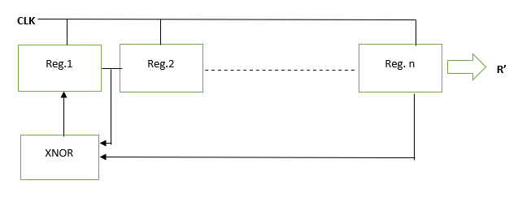
General block diagram

Slide 5
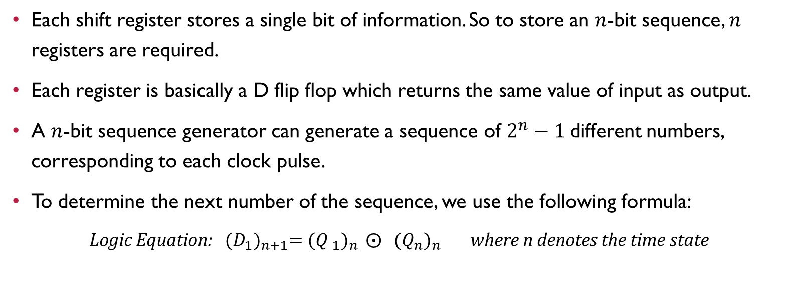
LOGIC PROCESS
Each shift register stores a single bit of information. So to store an $n$-bit sequence, $n$ registers are required.
Each register is basically a D flip flop which returns the same value of input as output.
A $n$-bit sequence generator can generate a sequence of $2^{n}−1$different numbers, corresponding to each clock pulse.
To determine the next number of the sequence, we use the following formula:
Logic Equation: ${(D_{1})}_{n+1}=({{Q }_{1})}_{n} ⨀{ {{(Q}_{n})}_{n}}$ where n denotes the time state

Slide 6
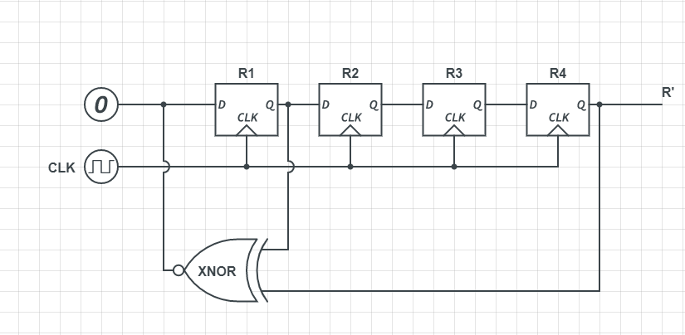
4-bit pn sequence generator: Circuit diagram

Slide 7
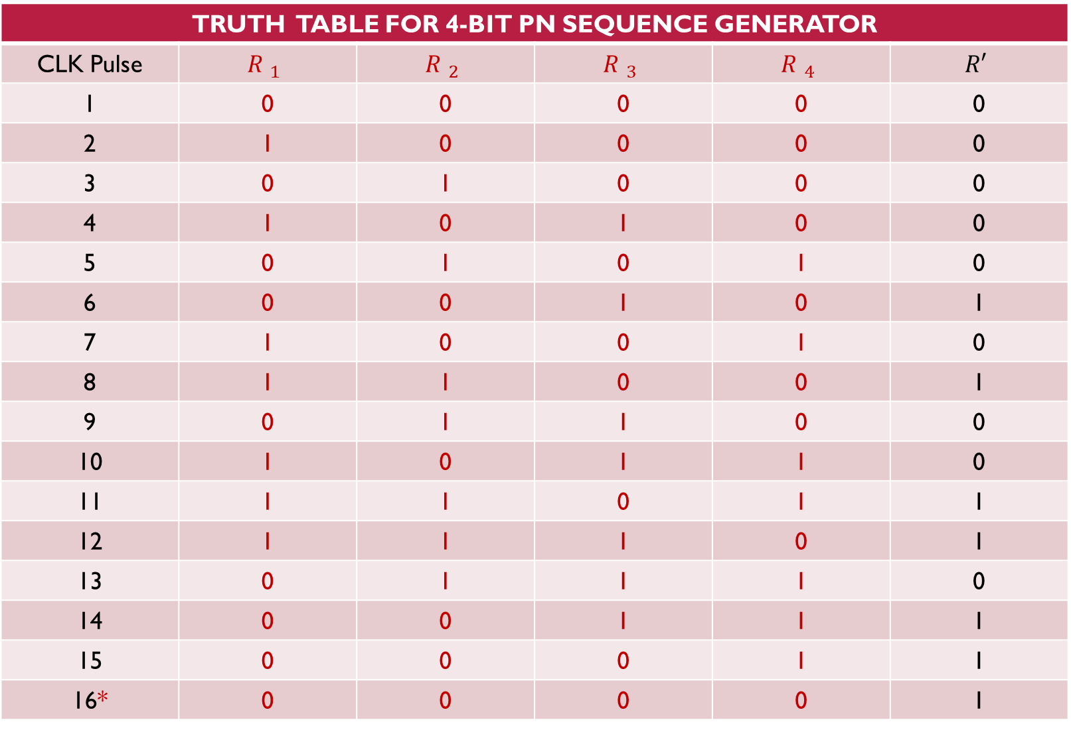
TRUTH TABLE FOR 4-BIT PN SEQUENCE GENERATOR
CLK Pulse | $${R }_{1}$$ | $${R }_{2}$$ | $${R }_{3}$$ | $${R }_{4}$$ | $$R′$$
1 | 0 | 0 | 0 | 0 | 0
2 | 1 | 0 | 0 | 0 | 0
3 | 0 | 1 | 0 | 0 | 0
4 | 1 | 0 | 1 | 0 | 0
5 | 0 | 1 | 0 | 1 | 0
6 | 0 | 0 | 1 | 0 | 1
7 | 1 | 0 | 0 | 1 | 0
8 | 1 | 1 | 0 | 0 | 1
9 | 0 | 1 | 1 | 0 | 0
10 | 1 | 0 | 1 | 1 | 0
11 | 1 | 1 | 0 | 1 | 1
12 | 1 | 1 | 1 | 0 | 1
13 | 0 | 1 | 1 | 1 | 0
14 | 0 | 0 | 1 | 1 | 1
15 | 0 | 0 | 0 | 1 | 1
16* | 0 | 0 | 0 | 0 | 1

Slide 8
Applications of pn sequence generator
Used in GPS satellites.
Used in two-way communications.
Used in CDMA communication.

Slide 9
THANK YOU

